Slide 1
Virtual Design Review 2
Team 513
Automated Shaft Flux Measurement Device

Slide 2
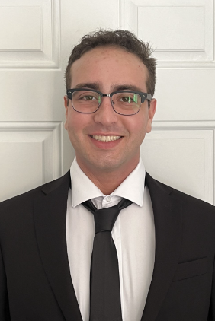
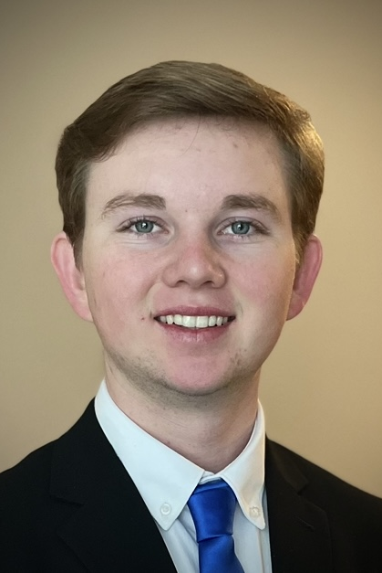

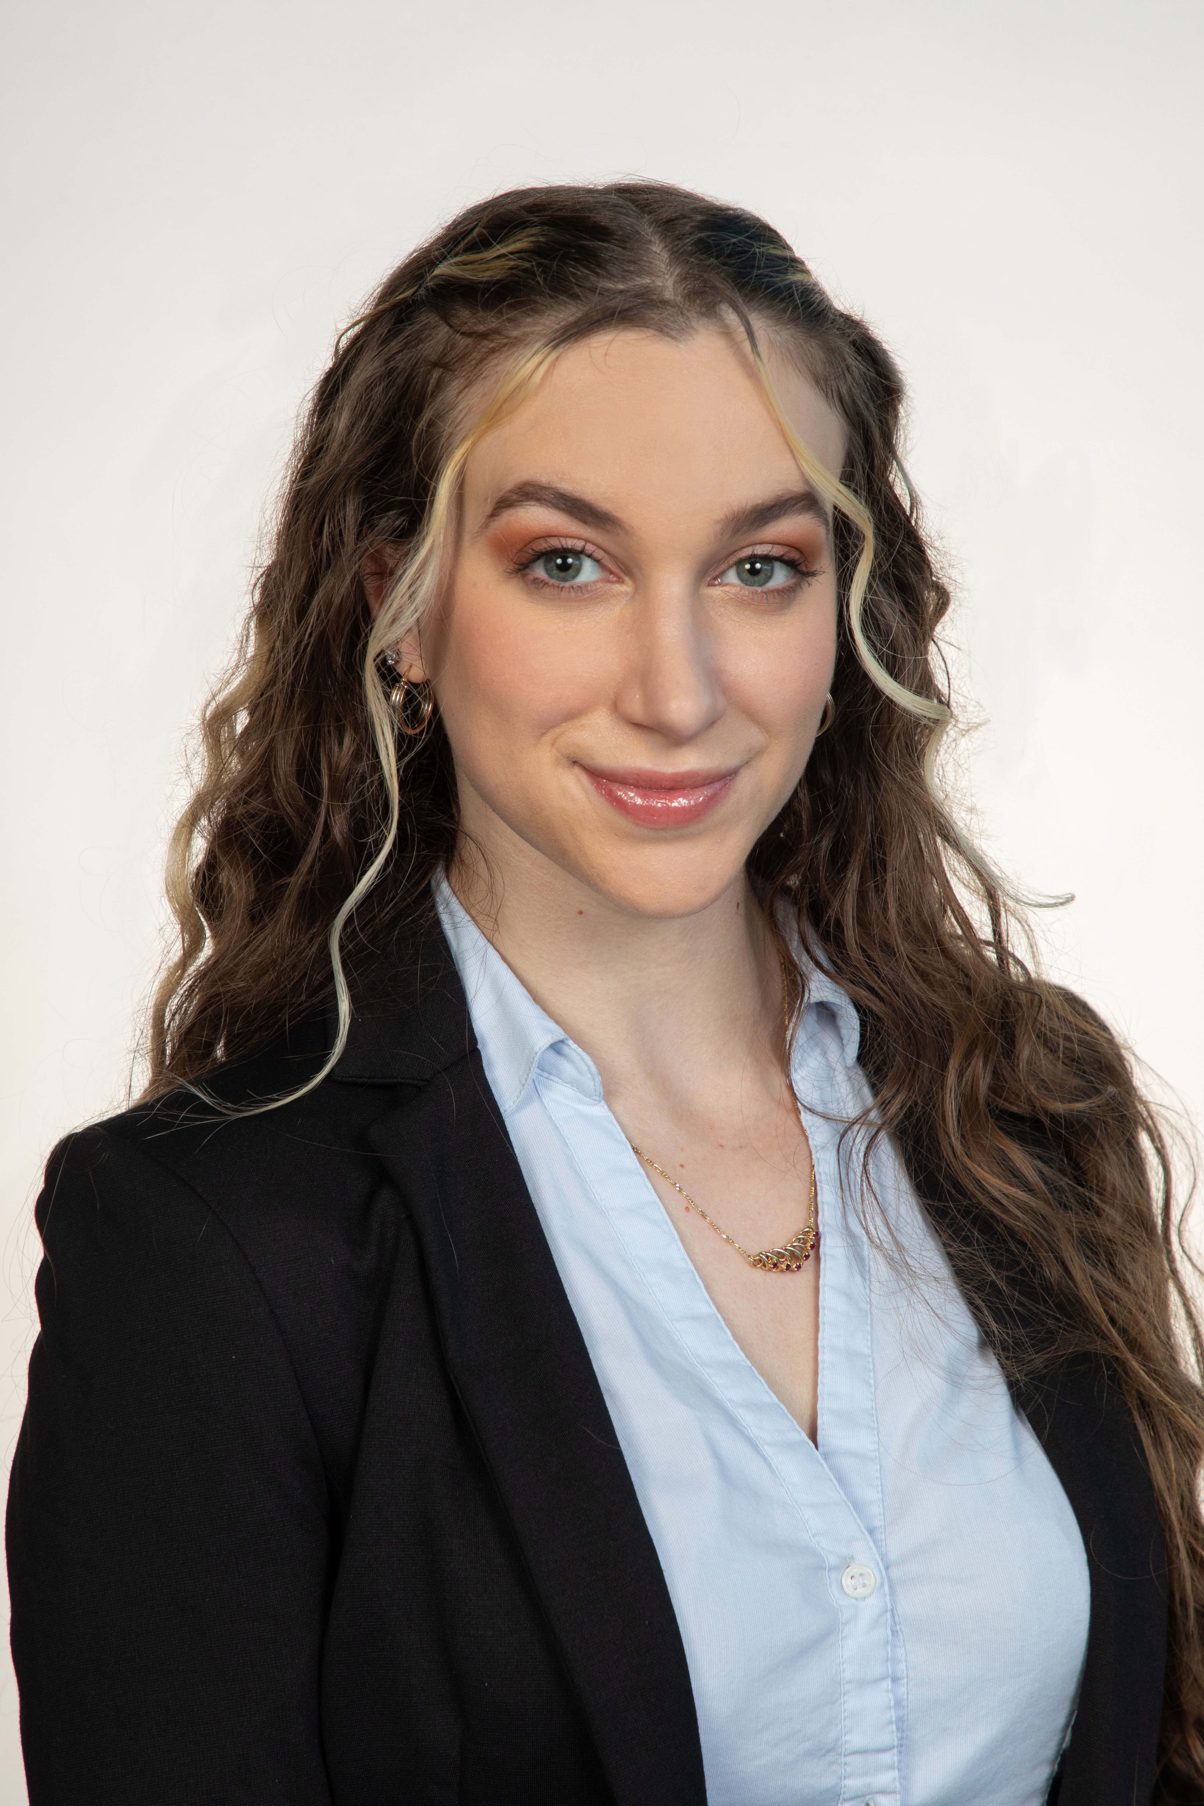
Team Introductions
Andrew Atallah
Andrew Atallah
Hardware Engineer
Sean Hemstreet
Design Engineer
Joshua Huls
Systems Engineer
Liora Louis
Materials &
Test Engineer

Slide 3


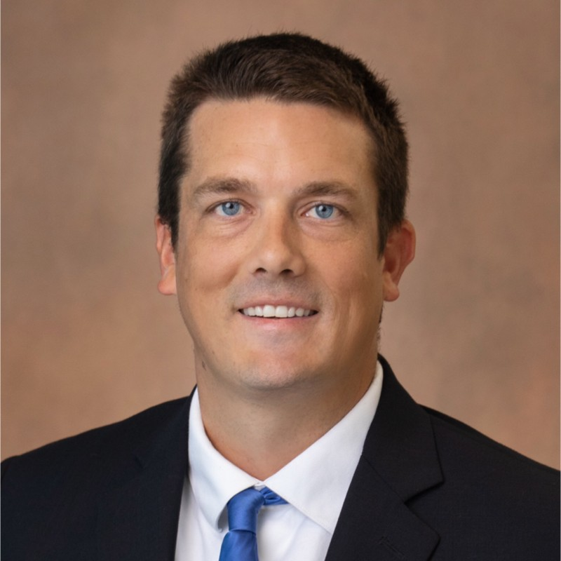

Sponsor and Advisor
Andrew Atallah
Engineering Mentor
William Bilbow
Director of Technology & Project Manager
Engineering Mentor
Cole Gray
Mechanical Design Engineer
Academic Advisor
Dr. Shayne McConomy
Senior Design Professor

Slide 4
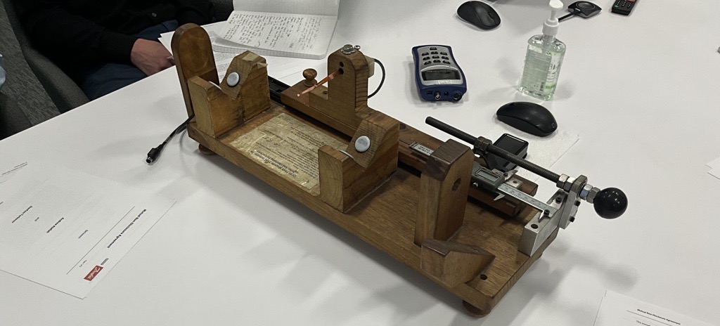
Objective
Andrew Atallah
The objective of this project is to design a device that will be capable of fully measuring and recording the magnetic flux of compressor shafts in an automated way that allows for accurate measurements, repeatability, and less overall firsthand work for the operator.

Slide 5
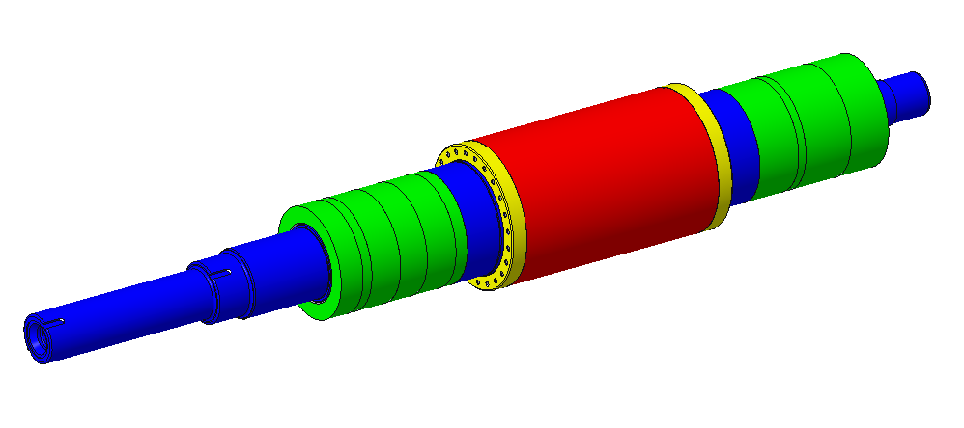
Danfoss VT Series Shaft
Andrew Atallah
Perimeter: 314 mm
Axial Length: 174 mm
~63 Measurements
5 mm Increments
2,200 Entries Per Test!
~35 Measurements

Slide 6
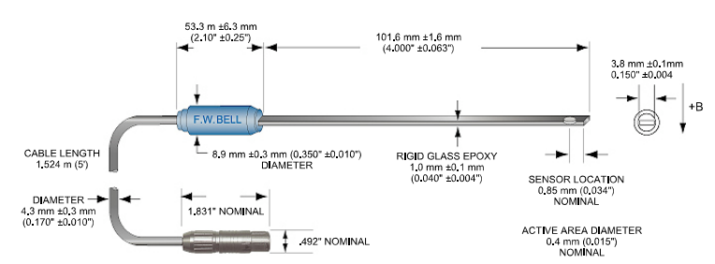
Fluxmeter
Andrew Atallah

Slide 7
Primary Market
Andrew Atallah

Slide 8




Secondary Market
Andrew Atallah
Competing Companies
Research Facilities

Slide 9




Key Goals
Andrew Atallah
Automation
Consistency
Adaptability
Accuracy

Slide 10
Assumptions
Andrew Atallah
Device is used over a period of 3 months per year.
MATLAB or an open-source software.
Given one working fluxmeter and sensor.
Testing will be performed at Danfoss.
Operator will be able to lift the shaft onto device.

Slide 11
Functional Decomposition
Andrew Atallah
AFM
Human Interaction
System
Controls

Slide 12
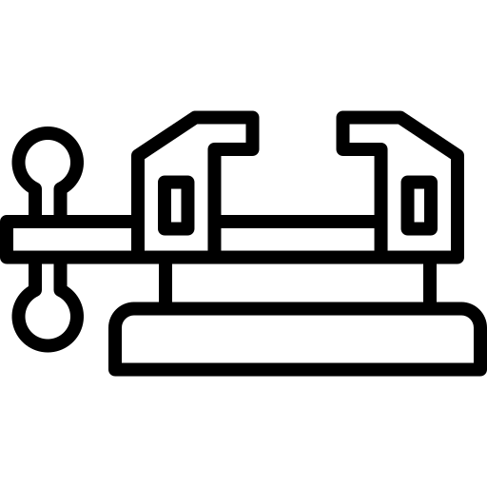




Targets and Metrics
Andrew Atallah
Secures Sample
Data Transfer
Repeatability
Resolution (5mm)
Structural Durability

Slide 13
Targets and Metrics
Andrew Atallah
Secures Sample
Data Transfer
Repeatability
Resolution (5mm)
Structural Durability

Slide 14
Targets and Metrics
Andrew Atallah
Secures Sample
Data Transfer
Repeatability
Resolution (5mm)
Structural Durability

Slide 15
Targets and Metrics
Andrew Atallah
Secures Sample
Data Transfer
Repeatability
Resolution (5mm)
Structural Durability

Slide 16
Targets and Metrics
Andrew Atallah
Secures Sample
Data Transfer
Repeatability
Resolution (5mm)
Structural Durability

Slide 17
Targets and Metrics
Andrew Atallah
Secures Sample
Data Transfer
Repeatability
Resolution (5mm)
Structural Durability

Slide 18

Concept Generation
Andrew Atallah
An in-depth process involving multiple team meetings in which team members produced design ideas together and discussed individuals' ideas as a team to compile a list of wildly varying designs.
Anti-Problem
Forced Analogy
Biomimicry
Crapshoot
Brainstorming

Slide 19
Concept Generation
Andrew Atallah
An in-depth process involving multiple team meetings in which team members produced design ideas together and discussed individuals' ideas as a team to compile a list of wildly varying designs.
Anti-Problem
Forced Analogy
Biomimicry
Crapshoot
Brainstorming

Slide 20
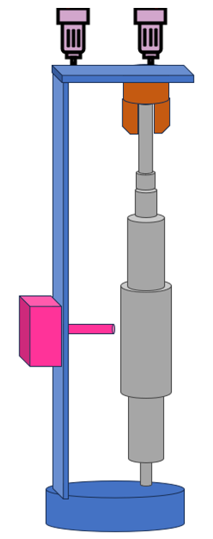
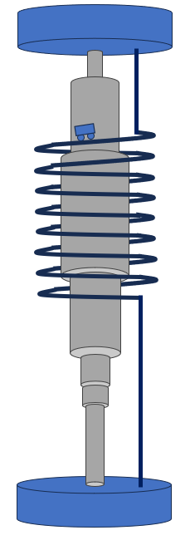
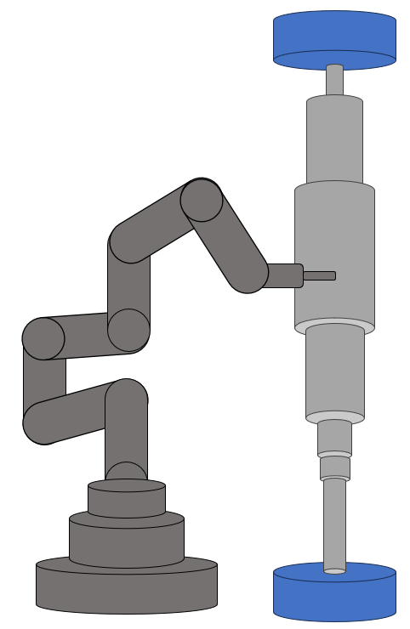
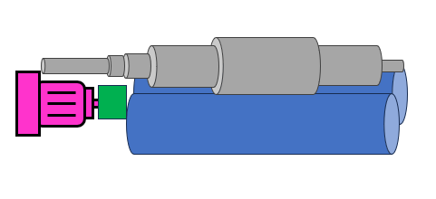
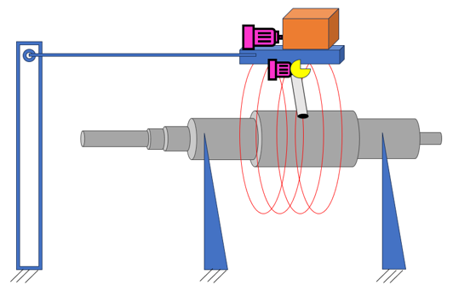
Medium Fidelity Concepts
Sean Hemstreet
1
2
5
1
2
3
4
5
3
4
Vertical Lathe Device
Roller Conveyor Belt Device
Robotic Arm Device
Typewriter Rail System Device
Helical Cage Device

Slide 21
Sean Hemstreet
1
Vertical Lathe Device
Motors
2
Secured using a chuck system
Lathe Chuck Head
3
Motorized Sensor Track
Rests on spinning platform
4
Flux meter sensor is on a vertical motorized track
5
Lazy Susan Slot

Slide 22
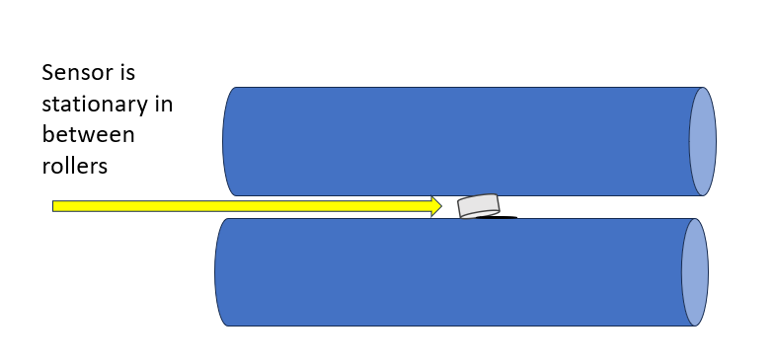
Sean Hemstreet
1
Roller Conveyor Belt Device
A conveyor belt of rollers is used to spin the shaft
2
3
A motor will drive the rollers to turn the shaft precisely
4
Will have consistent contact pressure on the shaft
5

Slide 23
Sean Hemstreet
1
Robotic Arm Device
Six degrees of freedom of movement
2
3
Suspended shaft with no rotation
4
Arm can move sensor probe to predetermined locations on shaft
5

Slide 24
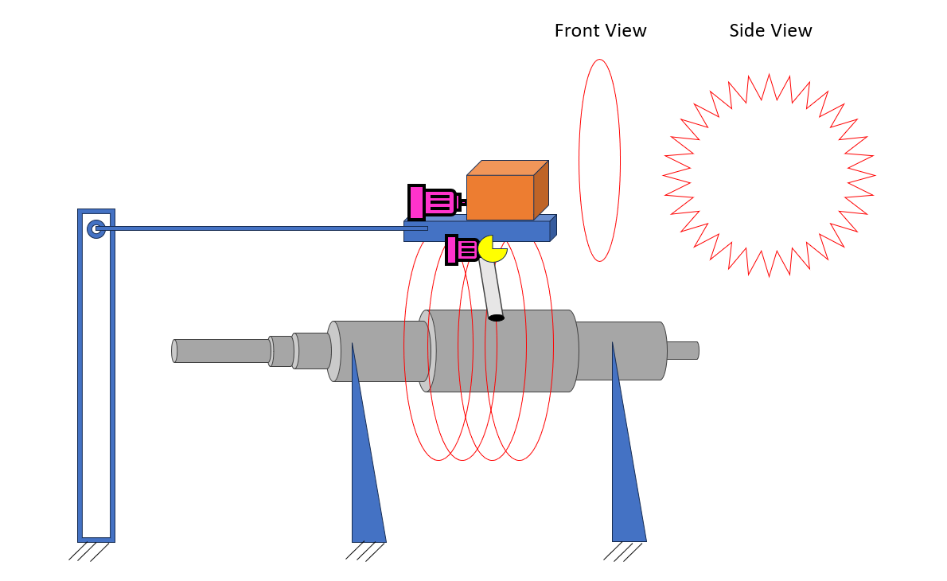
Sean Hemstreet
1
Typewriter Rail System Device
2
Shaft remains stationary during entire process
3
The device orbits around the shaft
4
= Cam & Follower
= Power Supply, Wires, etc.
The device is driven by a servo motor
5

Slide 25
Sean Hemstreet
1
Helical Cage System
2
The shaft is mounted vertically during the measuring process
3
The helical cage is only around the magnetic portion of the shaft
4
The flux meter probe rides along the helical track and takes measurements
5

Slide 26
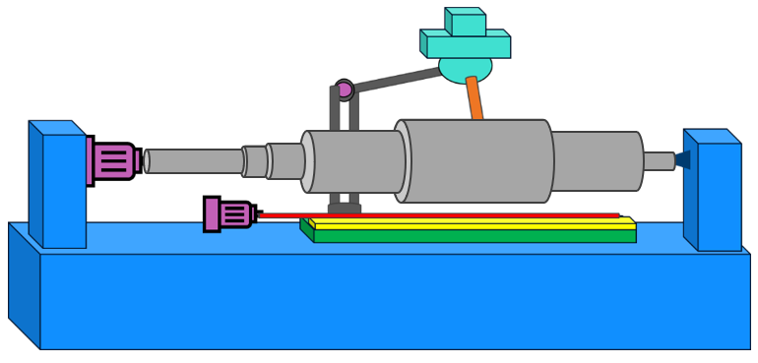
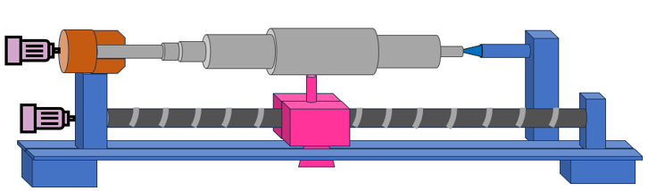
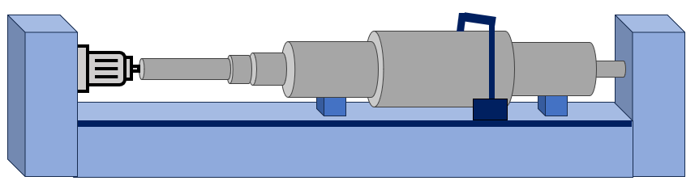
High Fidelity Concepts
Sean Hemstreet
1
2
3
1
2
3
Horizontal Lathe Device
Horizontal Roller Bearings Device
Lean and Peck Sensor Probe Device

Slide 27
Horizontal Lathe Device
Sean Hemstreet
1
Lathe Chuck Head
Live Center
2
Motors
Sensor
3
Table Plate Slot

Slide 28
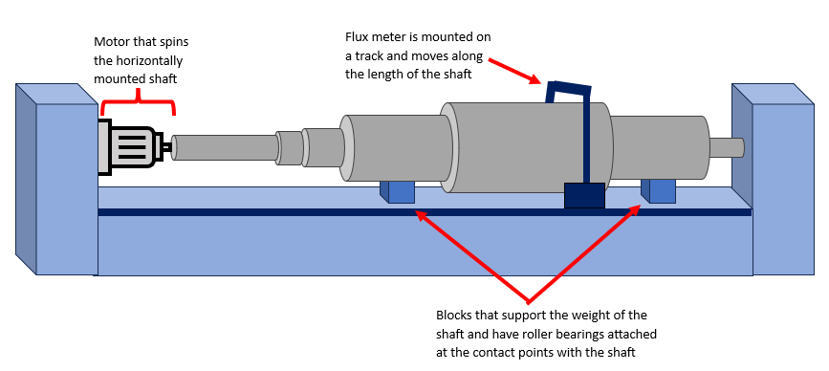
Roller Bearings Device
Sean Hemstreet
1
2
3

Slide 29
Lean and Peck Device
Sean Hemstreet
1
Tapered End Fitting with Bearing
Servo Motor
2
3
Worm Gear and Track
Two Stepper Motors

Slide 30
Concept Selection
Sean Hemstreet
Process of narrowing down all medium and high fidelity concepts into a list of a few designs ranked according to the customer’s design requirements.
Binary Pairwise Comparison and HoQ
Analytical Hierarchy Process
Final Selection
Pugh Charts

Slide 31



House of Quality
Sean Hemstreet
1
2
Provides reliable measurement feedback
Consistent measurements
3
4
5
Measures entire magnetic region of the shaft
Levels sample
Secures sample

Slide 32
Pugh Chart: First Iteration
Sean Hemstreet

Slide 33
Pugh Chart: First Iteration
Sean Hemstreet

Slide 34
Pugh Chart: Second Iteration
Sean Hemstreet

Slide 35
Pugh Chart: Second Iteration
Sean Hemstreet

Slide 36
Pugh Chart: Final Iteration
Sean Hemstreet

Slide 37
Pugh Chart: Final Iteration
Sean Hemstreet

Slide 38
Analytical Hierarchy Process
Sean Hemstreet
Concept | Alternative Value
Horizontal Lathe | 0.389
Vertical Lathe | 0.275
Typewriter System | 0.336

Slide 39
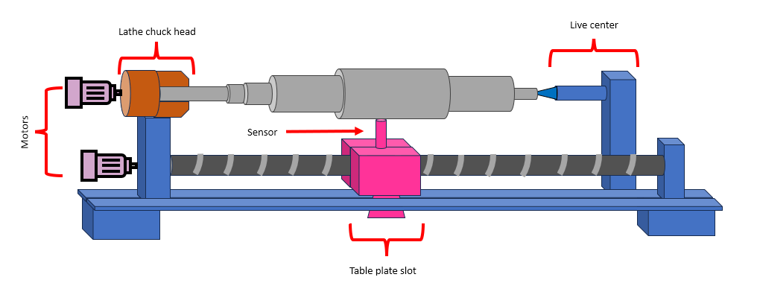

Final Selection
Sean Hemstreet
Reliable Measurement Feedback
Consistent Measurements
Measures Entire Region
Secures and Levels Samples
Horizontal Lathe
Adaptable

Slide 40
Future Work
Sean Hemstreet
Research
Purchasing
Prototyping
Testing

Slide 41
Backup Slides

Slide 42
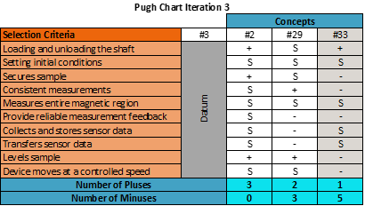
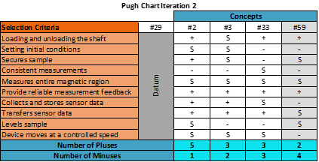
Pugh Charts
Sean Hemstreet
Concepts were compared with one another, with ones that score poorly by comparison being eliminated narrowing selection.

Slide 43
Current flux measurement system

Slide 44
This is 10-point
This is 15–point Times
This is 20–point
This is 25–point
This is 30–point
This is 35–point
This is 40–point
This is 50–point
This is 60–point
This is 72–point
Notes:
Use at least 20-point font in Room A105, B134, and B136
Use at least 25-point font in Room B135

Slide 45
College of Engineering Color Palette
1 2 3 4
Pantone: PMS 195 C
RGB: 120, 47, 64
Hex: #782F40
CMYK:19, 90, 50, 55
1 2 3 4
Pantone: Black C
RGB: 0, 0, 0
Hex: #000000
CMYK:0, 0, 0, 100
Garnet
Black
1 2 3 4
RGB: 238, 118, 36
Hex: #EE7624
CMYK:2, 66, 99, 0
1 2 3 4
Pantone: PMS 000C
RGB: 255, 255, 255
Hex: #FFFFFF
CMYK: 0, 0, 0, 0
Fang
Orange
White
Notes:
Avoid 75% Black in B135

Slide 46
Accent Color Palette
1 2 3 4
RGB: 0, 59, 111
Hex: #003B6F
CMYK:
1 2 3 4
RGB: 0, 59, 111
Hex: #003B6F
CMYK:
1 2 3 4
RGB: 251, 236, 93
Hex: #FBEC5D
CMYK:
1 2 3 4
RGB: 219, 215, 210
Hex: #DBD7D2
CMYK:
1 2 3 4
RGB: 251, 236, 93
Hex: #FBEC5D
CMYK:
1 2 3 4
RGB: 219, 215, 210
Hex: #DBD7D2
CMYK:
Tardis Blue
Tardis Blue
Corn
Timberwolf
Corn
Timberwolf
1 2 3 4
RGB: 206, 0, 88
Hex: #CE0058
CMYK: 0, 100, 43, 12
1 2 3 4
RGB: 206, 0, 88
Hex: #CE0058
CMYK: 0, 100, 43, 12
1 2 3 4
RGB: 104, 40, 96
Hex: #682860
CMYK:
1 2 3 4
RGB: 220, 220, 220
Hex: #DCDCDC
CMYK:
Rubine Red
Rubine Red
Imperial
Gainsboro
1 2 3 4
RGB: 72, 146, 155
Hex: #48929b
CMYK:
1 2 3 4
RGB: 64, 224, 208
Hex: #40E0D0
CMYK:
1 2 3 4
RGB: 255, 139, 0
Hex: #FF8B00
CMYK:
Asagi-iro
Turquoise
American Orange
Notes:
Remove American orange add hyperlink grey
Make corn the last for b135
All work in 134 imperial move later
Tardis doesn’t work in b136

Slide 47
F7AB19
D67F15
EE7624
D64615
F73119
Analogous
https://color.adobe.com/create/color-wheel
6E3610
F0A16C
EE7624
6E4931
BASB1C
Monochromatic
A14508
4BED3B
EE7624
250CED
2010A1
Triad
A1470C
FF8C40
EE7624
0098A1
24E2ED
Complementary
28A164
2FED8D
EE7624
0848A1
1871ED
Split Complementary
EDAC2F
3BED93
EE7624
0C6AED
ED2F18
Double Split Complementary
ED660C
C7ED3B
EE7624
0CE1ED
A418ED
Square
BA7E09
87724A
EE7624
60EFCF
09BA61
Compound
AD551A
6E3610
EE7624
FA7625
D46820
Shades
Notes:
These are the variants that work well with Fang Orange. The bolded items show well on the projectors.

Slide 48
85412D
8F3831
782f40
8F3176
792D85
Analogous
https://color.adobe.com/create/color-wheel
C44D69
8E626D
782F40
C48796
451B25
Monochromatic
C43959
78743B
782F40
236178
43A2C4
Triad
C43959
C46078
782F40
25C43D
2F783A
Complementary
93C460
577835
782F40
39C49D
297861
Split Complementary
784435
5A783B
782F40
237860
6E2978
Double Split Complementary
782337
78683b
782F40
237830
293978
Square
AB4D32
DEBAAF
782F40
5D8555
70AB32
Compound
38161E
C44D69
782F40
853447
5E2532
Shades

Slide 49
A105
A105
B135 Stage Left
B135 Stage Right
B136
B134, A105
B135

